Slide 1
LAVIDA CAFÉ
WITH LOVE

Slide 2
WHAT IS LAVIDA CAFÉ?
LaVida Cafe is a web application.
This system is developed to automate day to day activity of a restaurant. Restaurant is a kind of business that serves people all over world with ready made food. This system is developed to provide service facility to restaurant and also to the customer.
This restaurant management system can be used by employees in a restaurant to handle the clients, their orders and can help them easily find free tables or place orders. The services that are provided is food ordering and reservation table management by the customer through the system online, customer information management and waiter information management, menu information management and report.
The restaurant menu is organized by categories (appetizers, soups, salads, entrees, sides and drinks) of menu items.
Main objective build the system this is to provide ordering and reservation service by online to the customer.

Slide 3
NEED OF LAVIDA CAFÉ…
The main objective of this project is to develop a client/server model, which deals with all kind of services present in restaurant. The system has two parts first for the customers and the other for the management side.
The customer side allows the customer to view menu list and reserve meal with special time and can add extra services if need for special occasion and at the management side the staff is allowed to edit information regarding menu list, price, assigning cook, maintain information regarding the orders placed, etc.
This system is transparent about the services it provides and easy to use. For business owners it saves time, business resources and expenses.

Slide 4
SYSTEM REQUIREMENT SPECIFICATION
PROCESSOR | Intel Core i3
RAM | 4GB
HARD DISK | 500 GB
MONITOR | LCD Monitor
KEYBOARD | 101 Keys and more
MOUSE | Simple Mouse
PLATFORM | Eclipse Mars
OPERATING SYSTEM | WINDOW 10
LANGUAGES | HTML,JAVA,JS,CSS
SERVER PAGE | JSP
BROWSER | Google Chome

Slide 5
FUTURE SCOPE
This webpage is developed to help computer science students to learn about the Web application designing using JSP and HTML from their basic capabilities to build a complete working application from 5 scratch.
Further, it gives insight about how GUI interacts with server-side language, Java, and finally with the DB2 database.

Slide 6
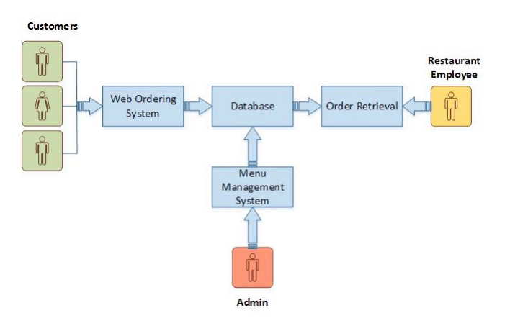
MODULAR REPRESENTATION OF DIAGRAM

Slide 7
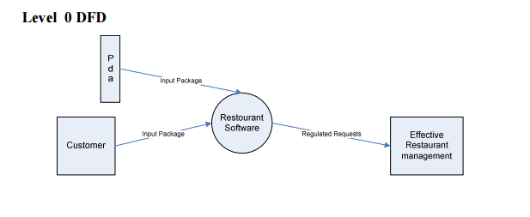
DATA FLOW DIAGRAM
This system will be going to help customer and administrator in restaurant especially part of online ordering and reservation table. of cook or edit the existing cook’s information from the cook’s list.
The result of online ordering and reservation table will give customer easy to make ordering and reservation table online and hopefully can smoother up the job of administrator and waiter.

Slide 8
SNAPSHOTS

Slide 9
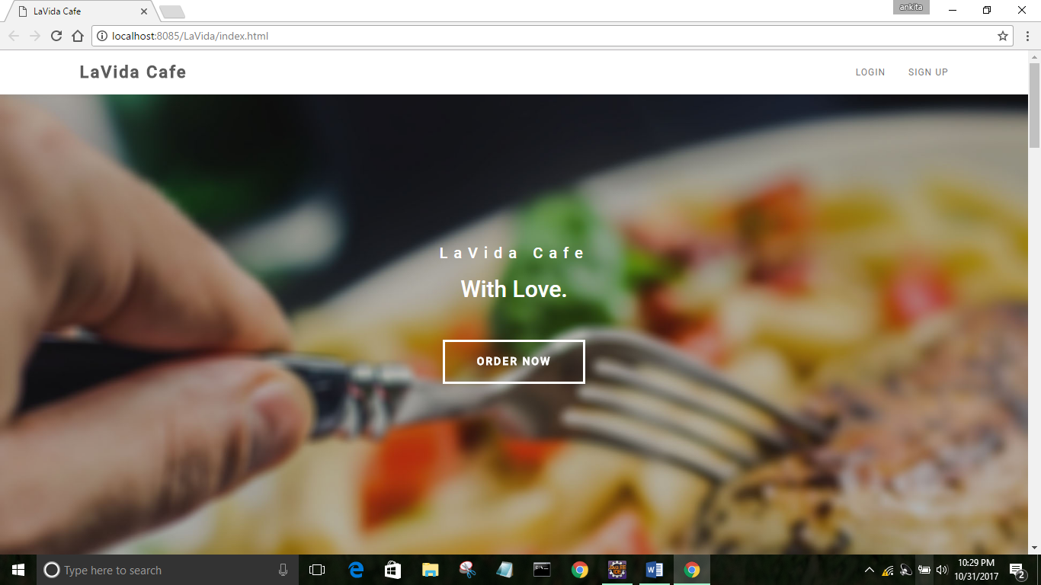
FRONT PAGE

Slide 10
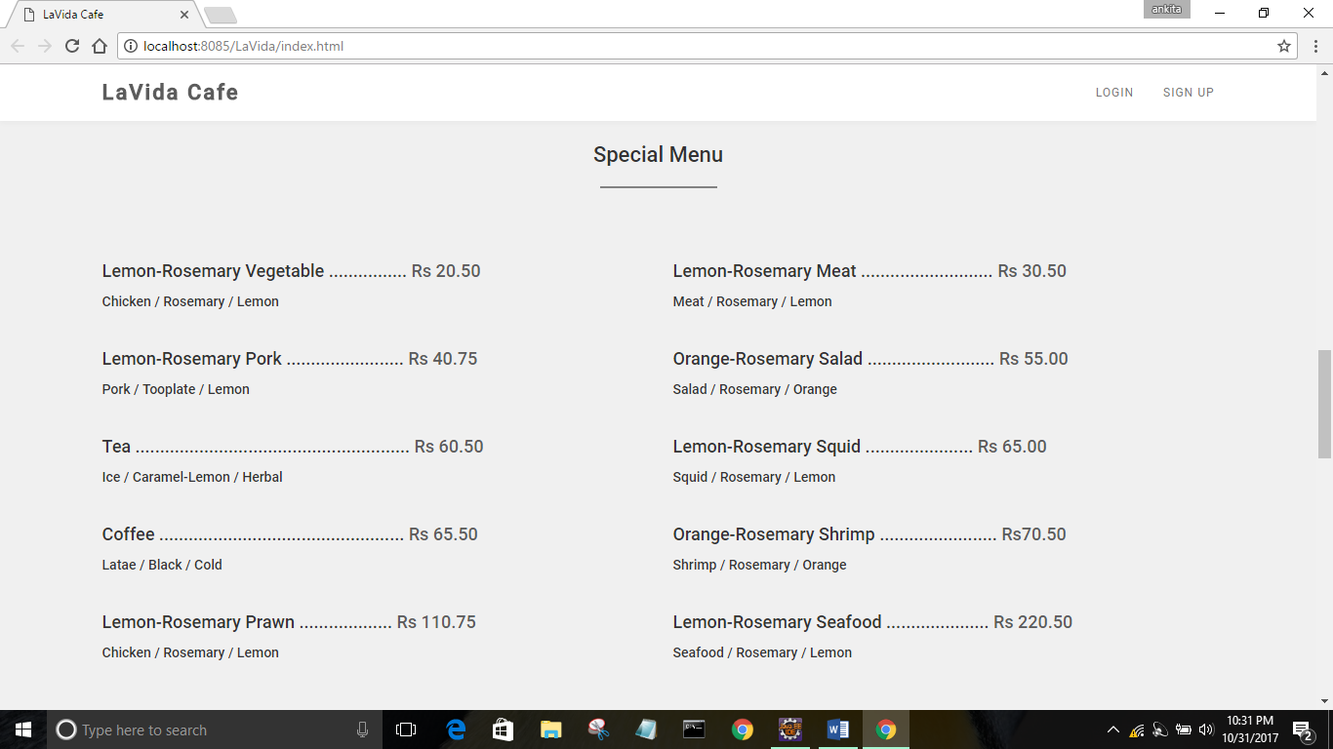
MENU PAGE

Slide 11
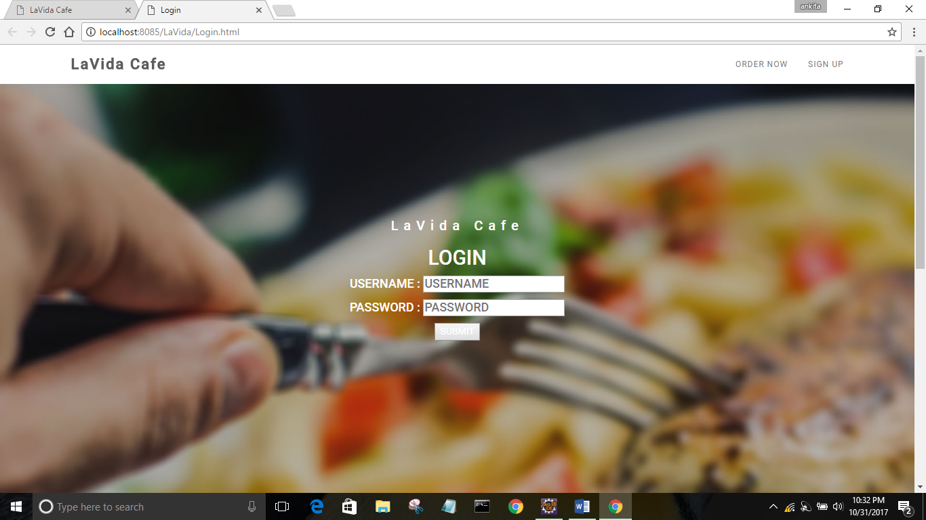
LOGIN PAGE

Slide 12
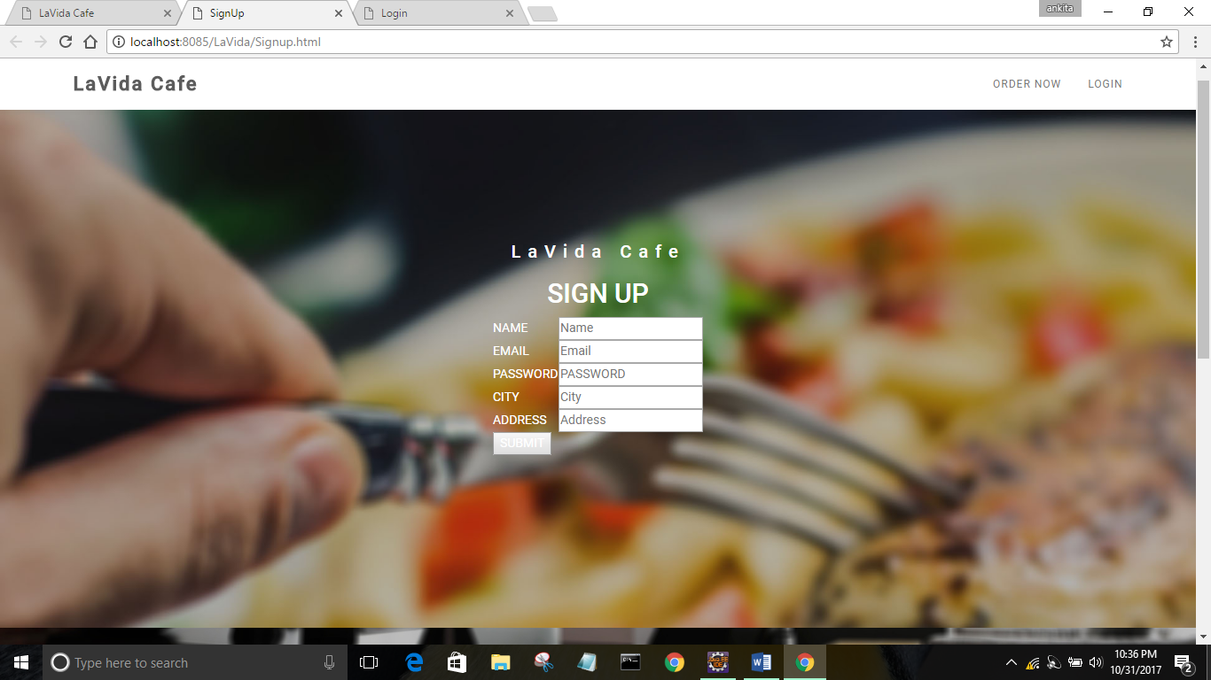
REGISTRATION PAGE

Slide 13
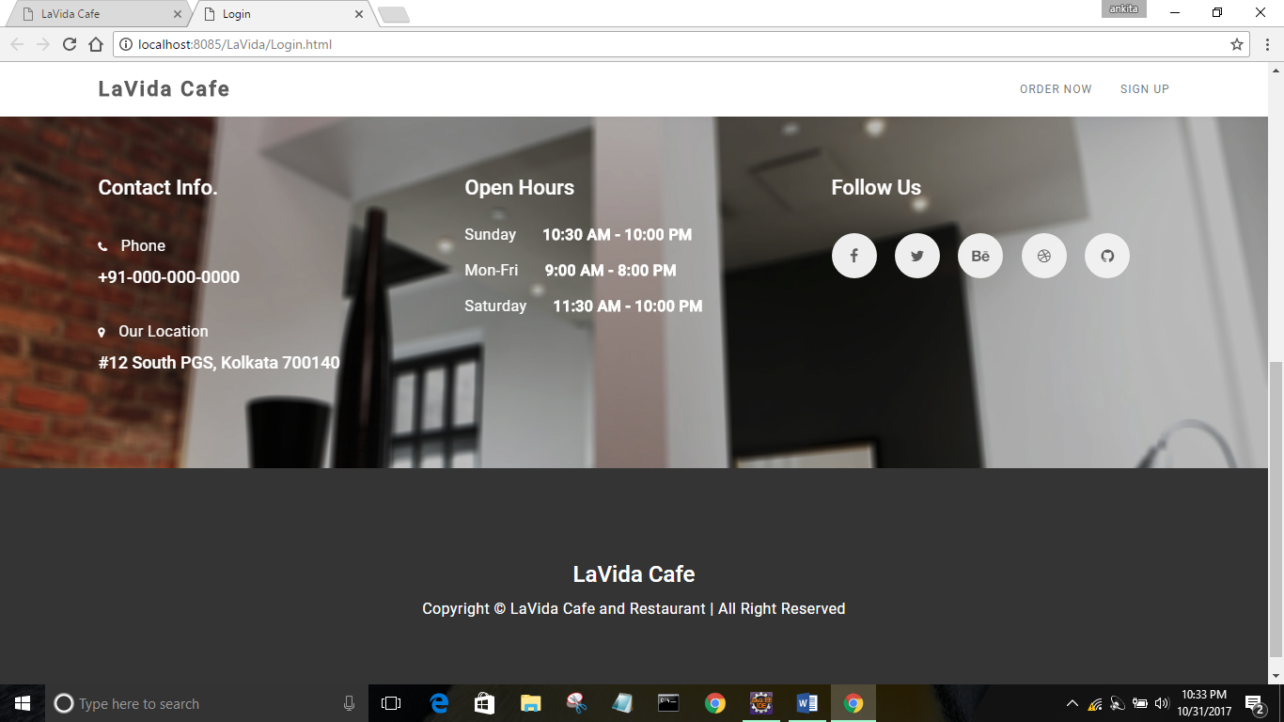
CONTACT AND LOCATION PAGE

Slide 14
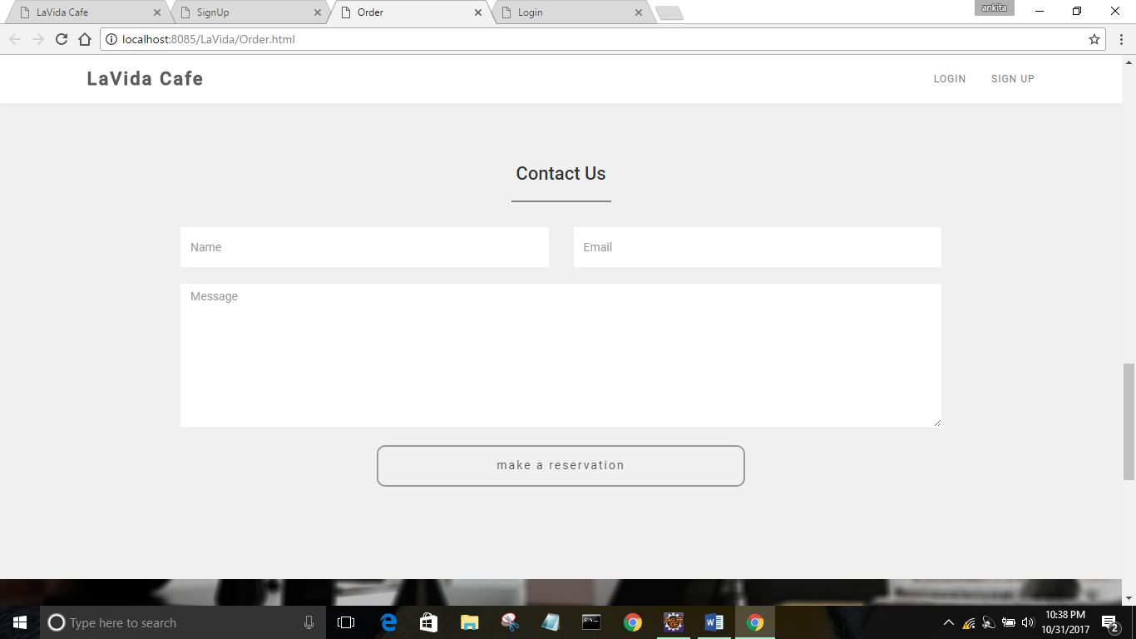
Reservation page

Slide 15
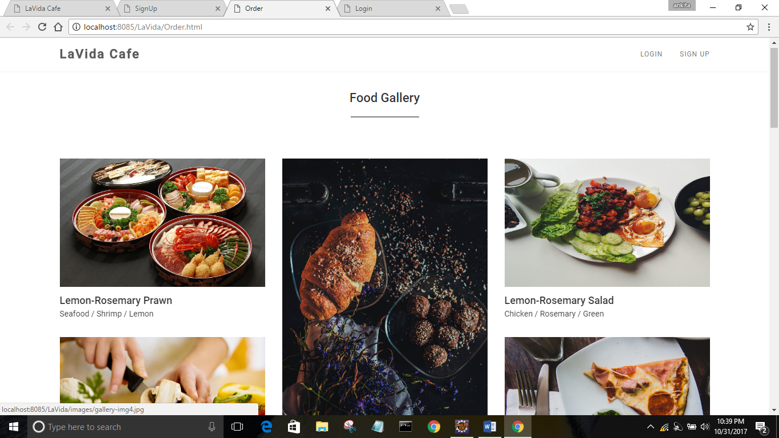
Food gallery

Slide 16
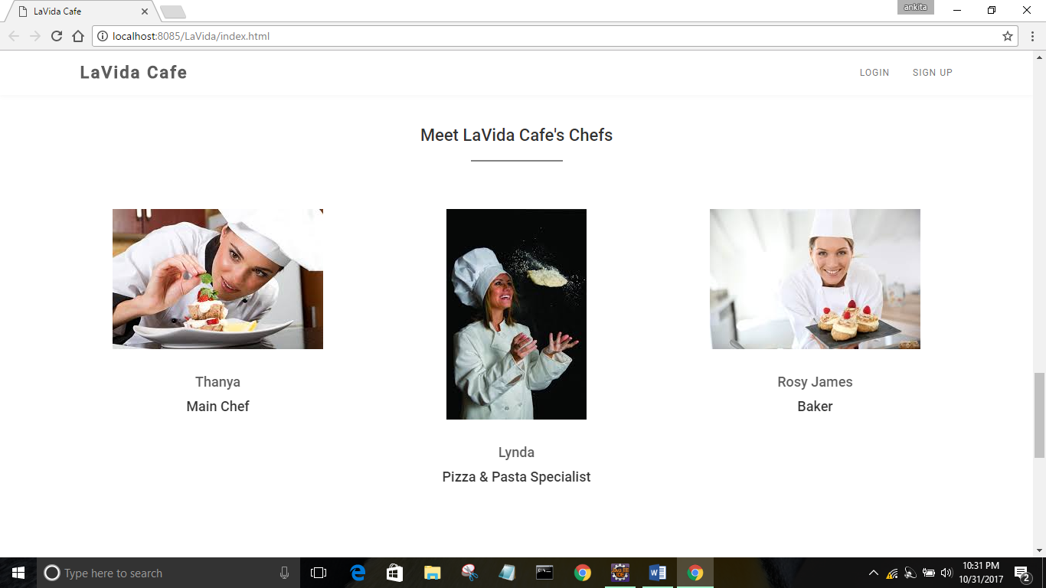
OUR TEAM

Slide 17
THANK YOU
SUBMITTEED BY :
ANKITA SINHA(15BCS2240)

